Slide 1
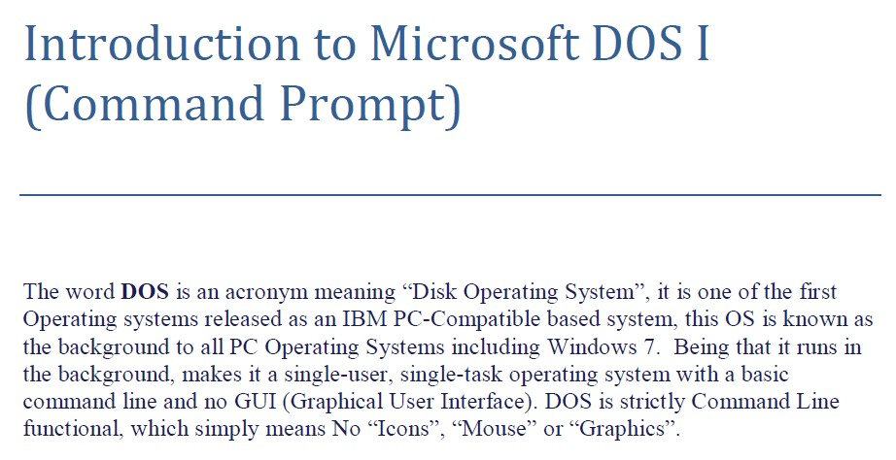
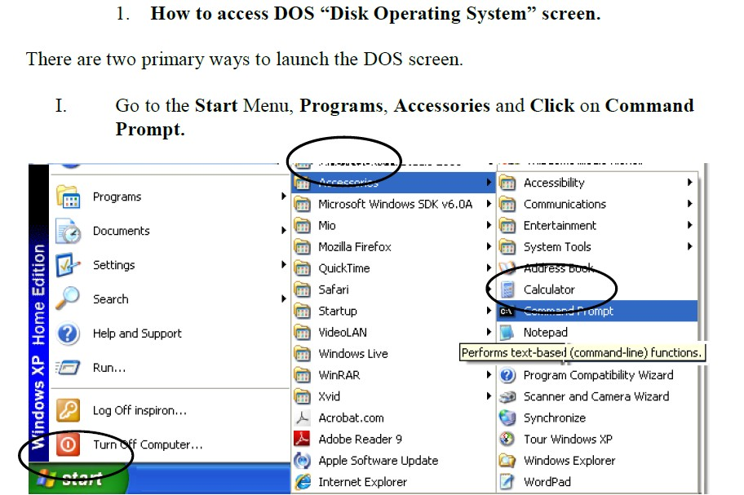
ةداملا سردم
ميهاربا بحاص ةدايم .م.م
ةيئابرهكلا ةردقلا مسق
تابساحلا ىلولاا ةلحرملا

Slide 2
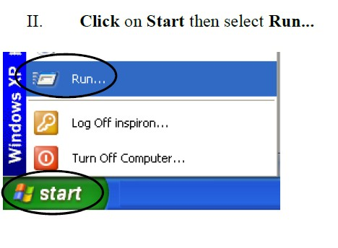
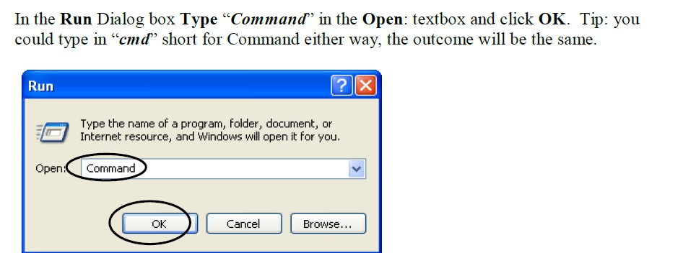
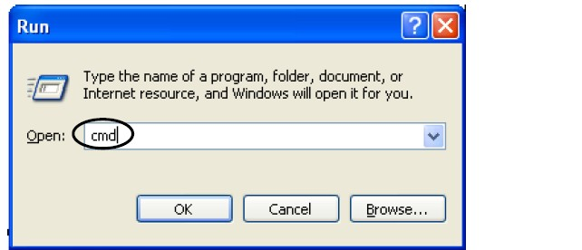

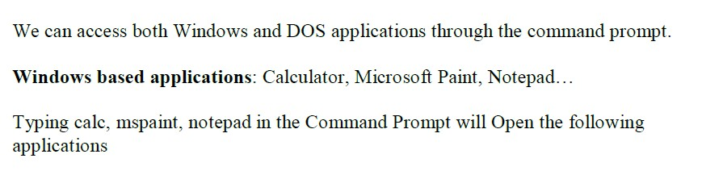
ةداملا سردم
ميهاربا بحاص ةدايم .م.م
ةيئابرهكلا ةردقلا مسق
تابساحلا ىلولاا ةلحرملا

Slide 3
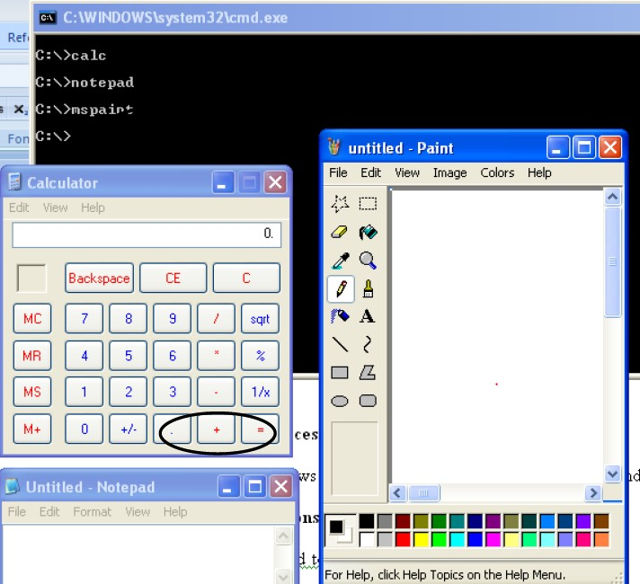
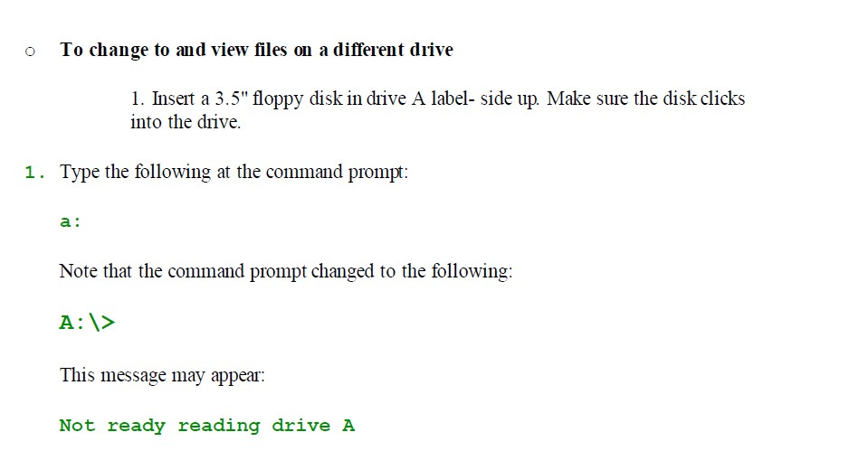
ةداملا سردم
ميهاربا بحاص ةدايم .م.م
ةيئابرهكلا ةردقلا مسق
تابساحلا ىلولاا ةلحرملا
(MS-DOS)رماوأ

Slide 4
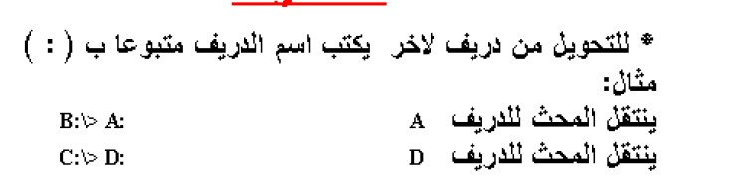

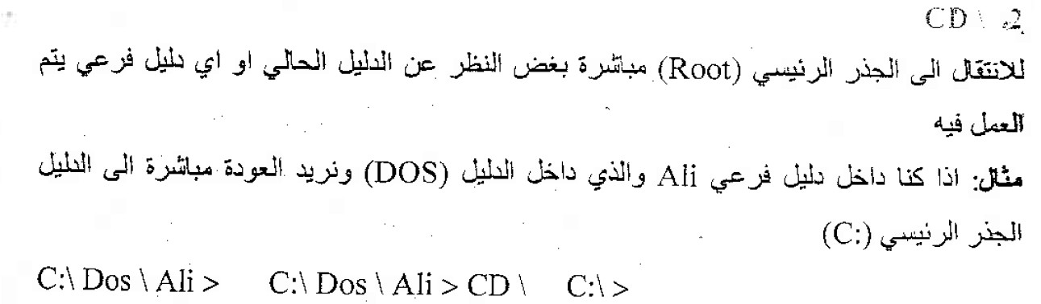
ةداملا سردم
ميهاربا بحاص ةدايم .م.م
ةيئابرهكلا ةردقلا مسق
تابساحلا ىلولاا ةلحرملا
Changing Back to the Root Directory
Next, you will change from the DOS directory to the root directory. The root
directory is the directory you were in before you changed to the DOS
directory.
Before you begin this section, make sure your command prompt looks like the
following:
C:\DOS>
o To change to the root directory

Slide 5
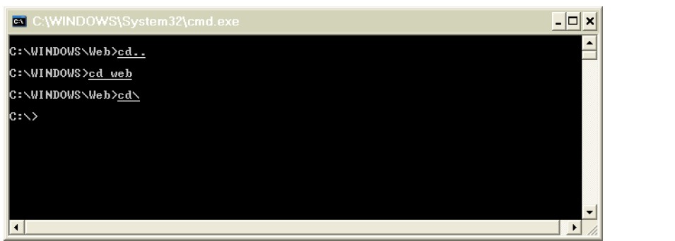
ةداملا سردم
ميهاربا بحاص ةدايم .م.م
ةيئابرهكلا ةردقلا مسق
تابساحلا ىلولاا ةلحرملا
cd \
Note that the slash you type in this command is a backslash (\), not a forward
slash (/).
No matter which directory you are in, this command always returns you to the
root directory of a drive. The root directory does not have a name. It is
simply
referred to by a backslash (\).
The command prompt should now look like the following:
C:\>
To change from a subdirectory back to the parent directory, type the following command:
cd..
)change director(cd)

Slide 6
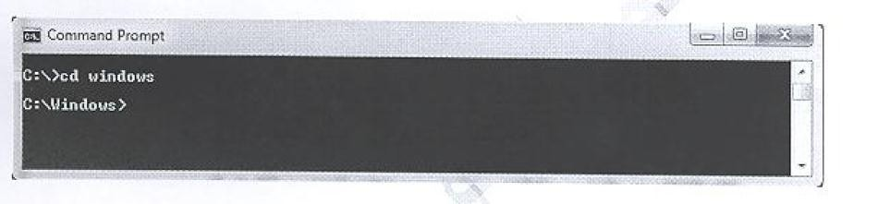
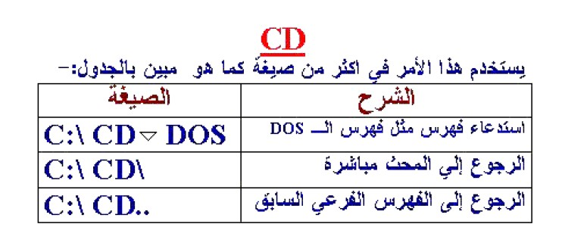
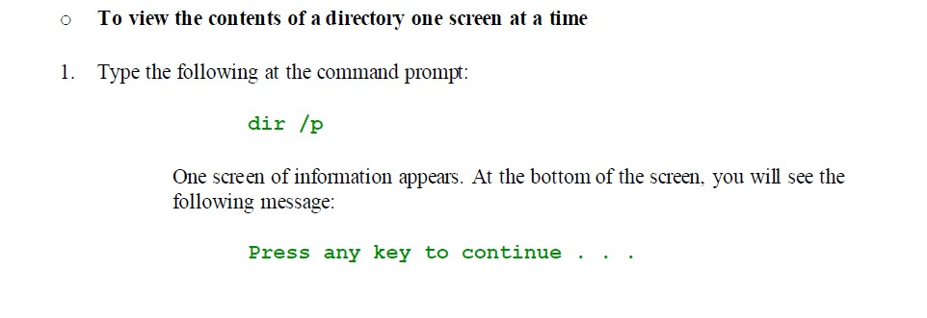
ةداملا سردم
ميهاربا بحاص ةدايم .م.م ةيئابرهكلا ةردقلا مسق
To change directories, you will use the cd command
تابساحلا ىلولاا ةلحرملا
To view the next screen of information, press any key on your keyboard.

Slide 7
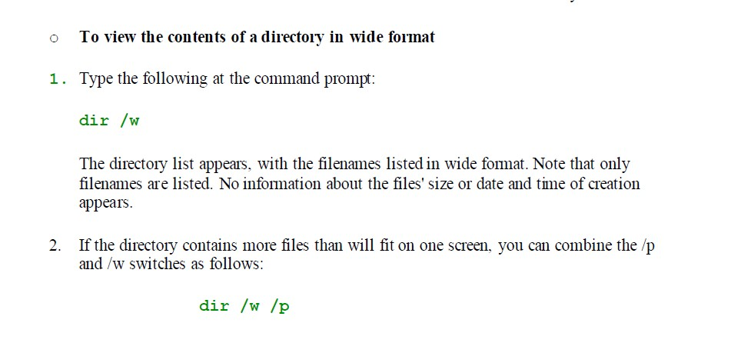
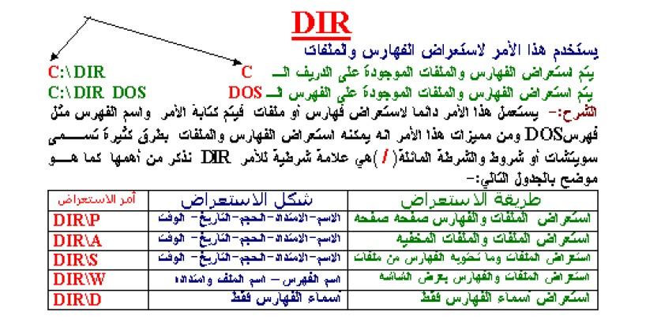
ةداملا سردم
ميهاربا بحاص ةدايم .م.م
ةيئابرهكلا ةردقلا مسق
تابساحلا ىلولاا ةلحرملا
VER
The following message appears on your screen:
MS-DOS version 6.22

Slide 8


ةداملا سردم
ميهاربا بحاص ةدايم .م.م
ةيئابرهكلا ةردقلا مسق
تابساحلا ىلولاا ةلحرملا
CLS
The CLS or CLRSCR command clears the terminal screen.
(Renaming Files)(REN)

Slide 9
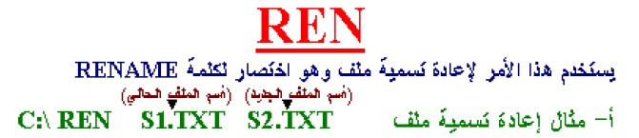
ةداملا سردم
ميهاربا بحاص ةدايم .م.م ةيئابرهكلا ةردقلا مسق
تابساحلا ىلولاا ةلحرملا
This section explains how to rename files. You may want to rename a file if the information in it changes or if you decide you prefer another name. To rename a file, you will use the ren command. The ren command stands for "rename." When you use the ren command, you must include two parameters.
The first is the file you want to rename, and the second is the new name for the file. You separate the two names with a space. The ren command follows this pattern:
ren oldname newname
DATE
MS-DOS records the current date for each file you create or change; this date is listed next to the filename in the directory.
DATE [mm-dd-yy]
Parameter mm-dd-yy
Sets the date you specify. Values for day, month, and year must be separated by periods (.), hyphens (-), or slash marks (/). The date format depends on the COUNTRY setting you are using in your CONFIG.SYS file. The following list shows the valid values for the month, day, and year portions of the mm-dd-yy parameter.
mm 1 through 12
dd 1 through 31
yy 80 through 99 or 1980 through 2099 >

Slide 10
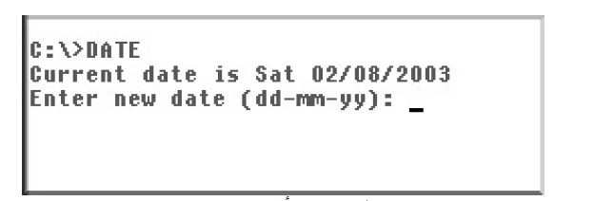
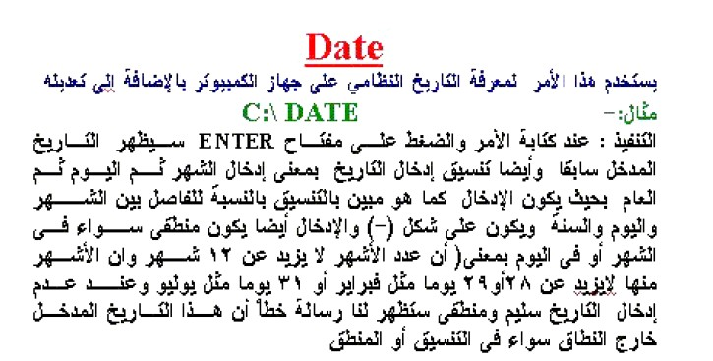
ةداملا سردم
ميهاربا بحاص ةدايم .م.م
ةيئابرهكلا ةردقلا مسق
تابساحلا ىلولاا ةلحرملا
TIME
Display the system time and waits for the user to enter a new time [Hours][Min][Sec][PARTS OF SECOND]

Slide 11
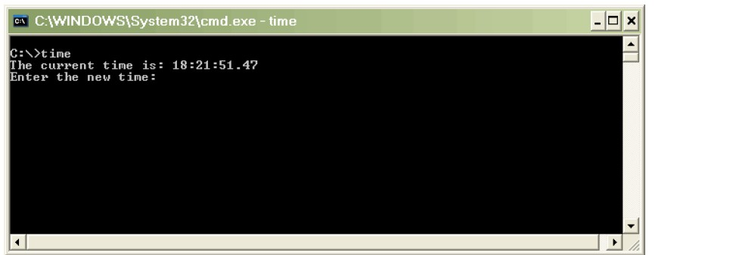
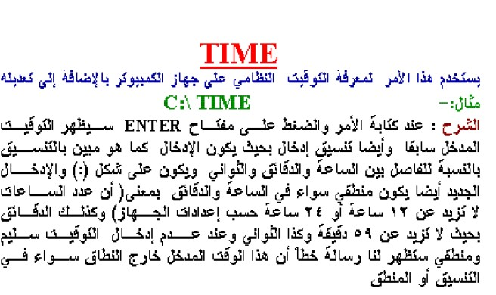
ةداملا سردم
ميهاربا بحاص ةدايم .م.م
ةيئابرهكلا ةردقلا مسق
تابساحلا ىلولاا ةلحرملا
(Make Directory) (md)
To create directory named FRUIT
1. Type the following at the command prompt:

Slide 12

ةداملا سردم
ميهاربا بحاص ةدايم .م.م
ةيئابرهكلا ةردقلا مسق
تابساحلا ىلولاا ةلحرملا
md fruit
You have now creat ed a directory named FRUIT. You won't see the new FRUIT
directory until you carry out the dir command in the next step.
2. To confirm that you successfully created the FRUIT directory, type the following at the command prompt:
dir
or
dir /p
Look through the directory list. A new entry somewhere in the list should look
similar to the following:
FRUIT <DIR> 09-25-93 12:09p
)Deleting a Directory)(RD)
To delete the GRAPES directory
1. Type the following at the command prompt:
rd grapes

Slide 13
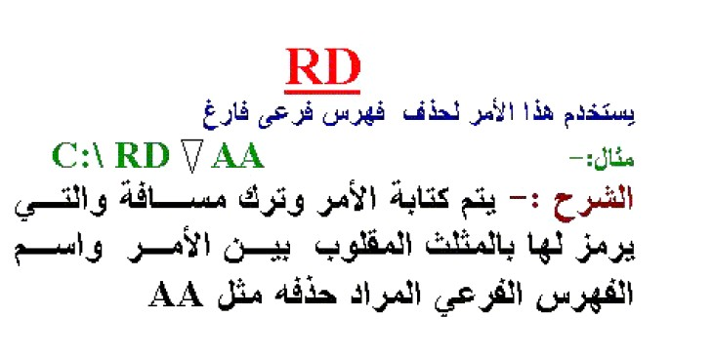
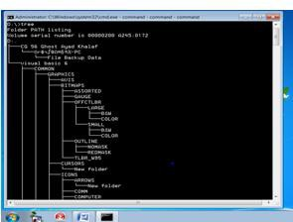
ةداملا سردم
ميهاربا بحاص ةدايم .م.م ةيئابرهكلا ةردقلا مسق
تابساحلا ىلولاا ةلحرملا
2. To confirm that you successfully deleted the GRAPES directory, type the following at the
command prompt:
dir
The GRAPES directory should no longer appear in the directory list.
TREE
To display the names of all the subdirectories on the disk in your current drive, type the following command:
tree

Slide 14
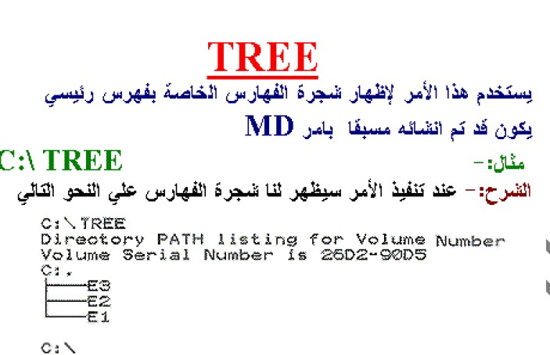
ةداملا سردم
ميهاربا بحاص ةدايم .م.م
ةيئابرهكلا ةردقلا مسق
تابساحلا ىلولاا ةلحرملا
EXIT
Exits the current
command processor

